Slide 1
CSE4204 LAB-2 : GLSL – Attribute, Uniform, Varying and More
Mohammad Imrul Jubair

Slide 2
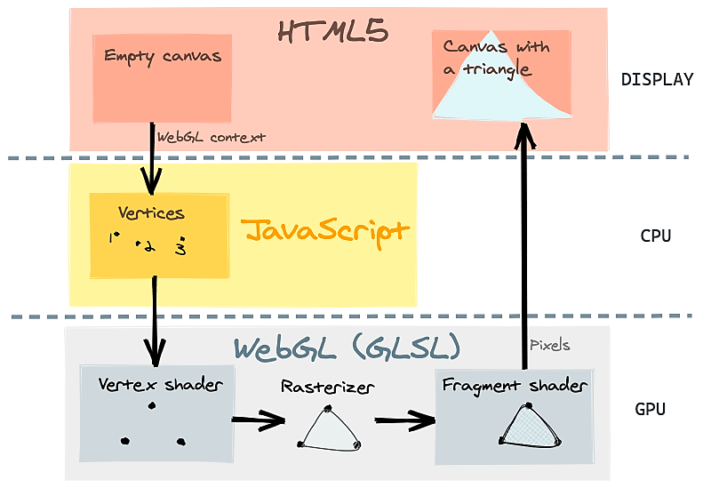
Recap
var canvas = document.getElementById("webglcanvas");
var gl = canvas.getContext("webgl");
var vertexShaderSource =
`attribute vec3 a_coords;
void main() {
gl_Position = vec4(a_coords, 1.0); }`;
var fragmentShaderSource =
`void main() {
gl_FragColor = vec4(1.0, 0.0, 0.0, 1.0); }`;
var vsh = gl.createShader( gl.VERTEX_SHADER );
gl.shaderSource( vsh, vertexShaderSource );
gl.compileShader( vsh );
var fsh = gl.createShader( gl.FRAGMENT_SHADER );
gl.shaderSource( fsh, fragmentShaderSource );
gl.compileShader( fsh );
var prog = gl.createProgram();
gl.attachShader( prog, vsh );
gl.attachShader( prog, fsh );
gl.linkProgram( prog );
gl.useProgram(prog);
var a_coords_location = gl.getAttribLocation(prog, "a_coords");
var coords = new Float32Array( [0.0, 0.0, 0.0,
0.0, 0.5, 0.0,
0.5, 0.0, 0.0] );
var a_coords_buffer = gl.createBuffer();
gl.bindBuffer(gl.ARRAY_BUFFER, a_coords_buffer);
gl.bufferData(gl.ARRAY_BUFFER, coords, gl.STATIC_DRAW);
gl.vertexAttribPointer(a_coords_location, 3, gl.FLOAT, false, 0, 0);
gl.enableVertexAttribArray(a_coords_location);
gl.clearColor(0.75, 0.75, 0.75, 1.0);
gl.clear(gl.COLOR_BUFFER_BIT);
gl.drawArrays(gl.TRIANGLES, 0, 3);
Canvas and WebGL context
Create and Compile Shaders
Associate the shader variable
Define geometry + color
and store it in buffer
Draw object
Source: https://www.h5w3.com/44328.html

Slide 3
Recap | Drawing a Triangle
Get the code:
rb.gy/zgu5ub

Slide 4
var canvas = document.getElementById("webglcanvas");
var gl = canvas.getContext("webgl");
var vertexShaderSource =
`attribute vec3 a_coords;
void main() {
gl_Position = vec4(a_coords, 1.0); }`;
var fragmentShaderSource =
`void main() {
gl_FragColor = vec4(1.0, 0.0, 0.0, 1.0); }`;
var vsh = gl.createShader( gl.VERTEX_SHADER );
gl.shaderSource( vsh, vertexShaderSource );
gl.compileShader( vsh );
var fsh = gl.createShader( gl.FRAGMENT_SHADER );
gl.shaderSource( fsh, fragmentShaderSource );
gl.compileShader( fsh );
var prog = gl.createProgram();
gl.attachShader( prog, vsh );
gl.attachShader( prog, fsh );
gl.linkProgram( prog );
gl.useProgram(prog);
var a_coords_location = gl.getAttribLocation(prog, "a_coords");
var coords = new Float32Array( [0.0, 0.0, 0.0,
0.0, 0.5, 0.0,
0.5, 0.0, 0.0] );
var a_coords_buffer = gl.createBuffer();
gl.bindBuffer(gl.ARRAY_BUFFER, a_coords_buffer);
gl.bufferData(gl.ARRAY_BUFFER, coords, gl.STATIC_DRAW);
gl.vertexAttribPointer(a_coords_location, 3, gl.FLOAT, false, 0, 0);
gl.enableVertexAttribArray(a_coords_location);
gl.clearColor(0.75, 0.75, 0.75, 1.0);
gl.clear(gl.COLOR_BUFFER_BIT);
gl.drawArrays(gl.TRIANGLES, 0, 3);
Canvas and WebGL context
Create and Compile Shaders
Associate the shader variable
Define geometry + color
and store it in buffer
Draw object

Slide 5
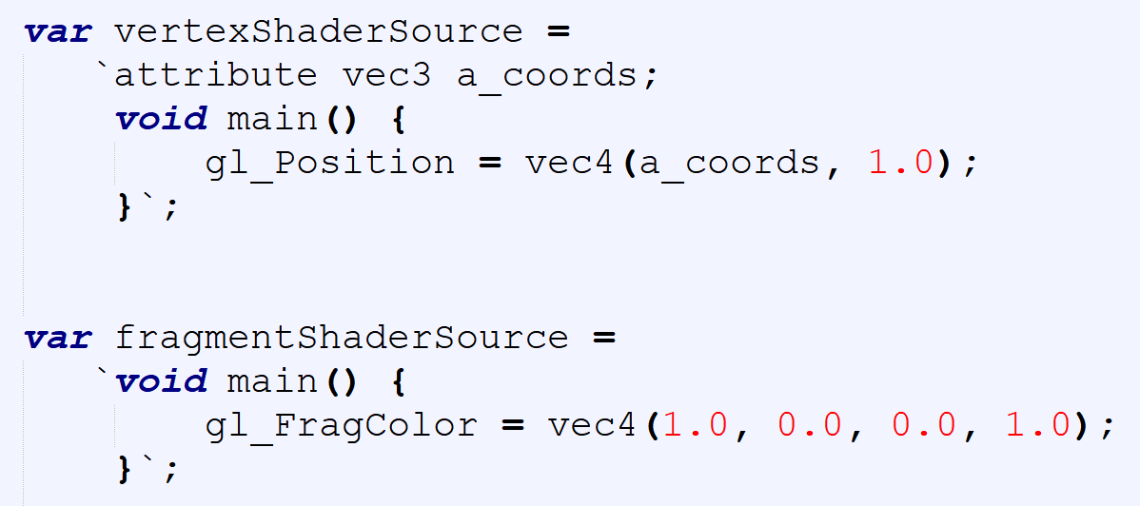
var canvas = document.getElementById("webglcanvas");
var gl = canvas.getContext("webgl");
var vertexShaderSource =
`attribute vec3 a_coords;
void main() {
gl_Position = vec4(a_coords, 1.0); }`;
var fragmentShaderSource =
`void main() {
gl_FragColor = vec4(1.0, 0.0, 0.0, 1.0); }`;
var vsh = gl.createShader( gl.VERTEX_SHADER );
gl.shaderSource( vsh, vertexShaderSource );
gl.compileShader( vsh );
var fsh = gl.createShader( gl.FRAGMENT_SHADER );
gl.shaderSource( fsh, fragmentShaderSource );
gl.compileShader( fsh );
var prog = gl.createProgram();
gl.attachShader( prog, vsh );
gl.attachShader( prog, fsh );
gl.linkProgram( prog );
gl.useProgram(prog);
var a_coords_location = gl.getAttribLocation(prog, "a_coords");
var coords = new Float32Array( [0.0, 0.0, 0.0,
0.0, 0.5, 0.0,
0.5, 0.0, 0.0] );
var a_coords_buffer = gl.createBuffer();
gl.bindBuffer(gl.ARRAY_BUFFER, a_coords_buffer);
gl.bufferData(gl.ARRAY_BUFFER, coords, gl.STATIC_DRAW);
gl.vertexAttribPointer(a_coords_location, 3, gl.FLOAT, false, 0, 0);
gl.enableVertexAttribArray(a_coords_location);
gl.clearColor(0.75, 0.75, 0.75, 1.0);
gl.clear(gl.COLOR_BUFFER_BIT);
gl.drawArrays(gl.TRIANGLES, 0, 3);
Canvas and WebGL context
Create and Compile Shaders
Associate the shader variable
Define geometry + color
and store it in buffer
Draw object

Slide 6
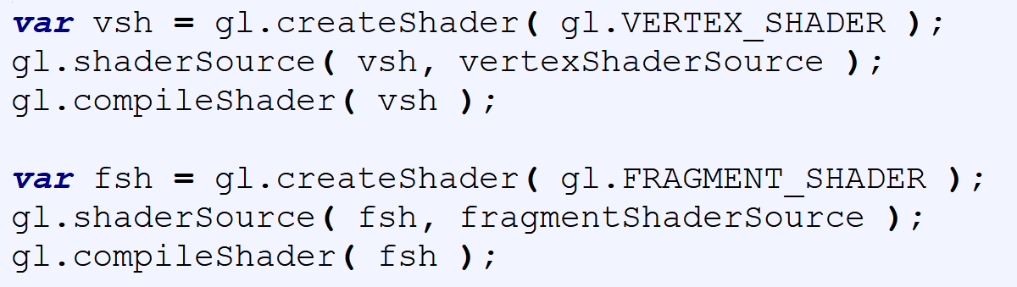
var canvas = document.getElementById("webglcanvas");
var gl = canvas.getContext("webgl");
var vertexShaderSource =
`attribute vec3 a_coords;
void main() {
gl_Position = vec4(a_coords, 1.0); }`;
var fragmentShaderSource =
`void main() {
gl_FragColor = vec4(1.0, 0.0, 0.0, 1.0); }`;
var vsh = gl.createShader( gl.VERTEX_SHADER );
gl.shaderSource( vsh, vertexShaderSource );
gl.compileShader( vsh );
var fsh = gl.createShader( gl.FRAGMENT_SHADER );
gl.shaderSource( fsh, fragmentShaderSource );
gl.compileShader( fsh );
var prog = gl.createProgram();
gl.attachShader( prog, vsh );
gl.attachShader( prog, fsh );
gl.linkProgram( prog );
gl.useProgram(prog);
var a_coords_location = gl.getAttribLocation(prog, "a_coords");
var coords = new Float32Array( [0.0, 0.0, 0.0,
0.0, 0.5, 0.0,
0.5, 0.0, 0.0] );
var a_coords_buffer = gl.createBuffer();
gl.bindBuffer(gl.ARRAY_BUFFER, a_coords_buffer);
gl.bufferData(gl.ARRAY_BUFFER, coords, gl.STATIC_DRAW);
gl.vertexAttribPointer(a_coords_location, 3, gl.FLOAT, false, 0, 0);
gl.enableVertexAttribArray(a_coords_location);
gl.clearColor(0.75, 0.75, 0.75, 1.0);
gl.clear(gl.COLOR_BUFFER_BIT);
gl.drawArrays(gl.TRIANGLES, 0, 3);
Canvas and WebGL context
Create and Compile Shaders
Associate the shader variable
Define geometry + color
and store it in buffer
Draw object

Slide 7
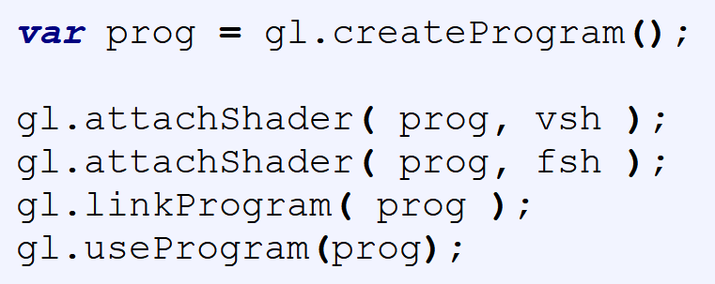
var canvas = document.getElementById("webglcanvas");
var gl = canvas.getContext("webgl");
var vertexShaderSource =
`attribute vec3 a_coords;
void main() {
gl_Position = vec4(a_coords, 1.0); }`;
var fragmentShaderSource =
`void main() {
gl_FragColor = vec4(1.0, 0.0, 0.0, 1.0); }`;
var vsh = gl.createShader( gl.VERTEX_SHADER );
gl.shaderSource( vsh, vertexShaderSource );
gl.compileShader( vsh );
var fsh = gl.createShader( gl.FRAGMENT_SHADER );
gl.shaderSource( fsh, fragmentShaderSource );
gl.compileShader( fsh );
var prog = gl.createProgram();
gl.attachShader( prog, vsh );
gl.attachShader( prog, fsh );
gl.linkProgram( prog );
gl.useProgram(prog);
var a_coords_location = gl.getAttribLocation(prog, "a_coords");
var coords = new Float32Array( [0.0, 0.0, 0.0,
0.0, 0.5, 0.0,
0.5, 0.0, 0.0] );
var a_coords_buffer = gl.createBuffer();
gl.bindBuffer(gl.ARRAY_BUFFER, a_coords_buffer);
gl.bufferData(gl.ARRAY_BUFFER, coords, gl.STATIC_DRAW);
gl.vertexAttribPointer(a_coords_location, 3, gl.FLOAT, false, 0, 0);
gl.enableVertexAttribArray(a_coords_location);
gl.clearColor(0.75, 0.75, 0.75, 1.0);
gl.clear(gl.COLOR_BUFFER_BIT);
gl.drawArrays(gl.TRIANGLES, 0, 3);
Canvas and WebGL context
Create and Compile Shaders
Associate the shader variable
Define geometry + color
and store it in buffer
Draw object

Slide 8

var canvas = document.getElementById("webglcanvas");
var gl = canvas.getContext("webgl");
var vertexShaderSource =
`attribute vec3 a_coords;
void main() {
gl_Position = vec4(a_coords, 1.0); }`;
var fragmentShaderSource =
`void main() {
gl_FragColor = vec4(1.0, 0.0, 0.0, 1.0); }`;
var vsh = gl.createShader( gl.VERTEX_SHADER );
gl.shaderSource( vsh, vertexShaderSource );
gl.compileShader( vsh );
var fsh = gl.createShader( gl.FRAGMENT_SHADER );
gl.shaderSource( fsh, fragmentShaderSource );
gl.compileShader( fsh );
var prog = gl.createProgram();
gl.attachShader( prog, vsh );
gl.attachShader( prog, fsh );
gl.linkProgram( prog );
gl.useProgram(prog);
var a_coords_location = gl.getAttribLocation(prog, "a_coords");
var coords = new Float32Array( [0.0, 0.0, 0.0,
0.0, 0.5, 0.0,
0.5, 0.0, 0.0] );
var a_coords_buffer = gl.createBuffer();
gl.bindBuffer(gl.ARRAY_BUFFER, a_coords_buffer);
gl.bufferData(gl.ARRAY_BUFFER, coords, gl.STATIC_DRAW);
gl.vertexAttribPointer(a_coords_location, 3, gl.FLOAT, false, 0, 0);
gl.enableVertexAttribArray(a_coords_location);
gl.clearColor(0.75, 0.75, 0.75, 1.0);
gl.clear(gl.COLOR_BUFFER_BIT);
gl.drawArrays(gl.TRIANGLES, 0, 3);
Canvas and WebGL context
Create and Compile Shaders
Associate the shader variable
Define geometry + color
and store it in buffer
Draw object

Slide 9
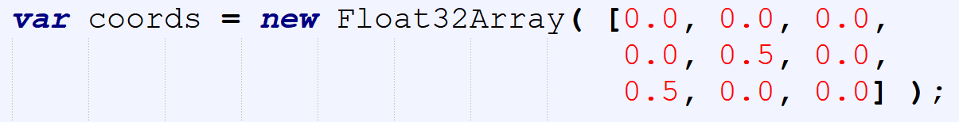
var canvas = document.getElementById("webglcanvas");
var gl = canvas.getContext("webgl");
var vertexShaderSource =
`attribute vec3 a_coords;
void main() {
gl_Position = vec4(a_coords, 1.0); }`;
var fragmentShaderSource =
`void main() {
gl_FragColor = vec4(1.0, 0.0, 0.0, 1.0); }`;
var vsh = gl.createShader( gl.VERTEX_SHADER );
gl.shaderSource( vsh, vertexShaderSource );
gl.compileShader( vsh );
var fsh = gl.createShader( gl.FRAGMENT_SHADER );
gl.shaderSource( fsh, fragmentShaderSource );
gl.compileShader( fsh );
var prog = gl.createProgram();
gl.attachShader( prog, vsh );
gl.attachShader( prog, fsh );
gl.linkProgram( prog );
gl.useProgram(prog);
var a_coords_location = gl.getAttribLocation(prog, "a_coords");
var coords = new Float32Array( [0.0, 0.0, 0.0,
0.0, 0.5, 0.0,
0.5, 0.0, 0.0] );
var a_coords_buffer = gl.createBuffer();
gl.bindBuffer(gl.ARRAY_BUFFER, a_coords_buffer);
gl.bufferData(gl.ARRAY_BUFFER, coords, gl.STATIC_DRAW);
gl.vertexAttribPointer(a_coords_location, 3, gl.FLOAT, false, 0, 0);
gl.enableVertexAttribArray(a_coords_location);
gl.clearColor(0.75, 0.75, 0.75, 1.0);
gl.clear(gl.COLOR_BUFFER_BIT);
gl.drawArrays(gl.TRIANGLES, 0, 3);
Canvas and WebGL context
Create and Compile Shaders
Associate the shader variable
Define geometry + color
and store it in buffer
Draw object

Slide 10
var canvas = document.getElementById("webglcanvas");
var gl = canvas.getContext("webgl");
var vertexShaderSource =
`attribute vec3 a_coords;
void main() {
gl_Position = vec4(a_coords, 1.0); }`;
var fragmentShaderSource =
`void main() {
gl_FragColor = vec4(1.0, 0.0, 0.0, 1.0); }`;
var vsh = gl.createShader( gl.VERTEX_SHADER );
gl.shaderSource( vsh, vertexShaderSource );
gl.compileShader( vsh );
var fsh = gl.createShader( gl.FRAGMENT_SHADER );
gl.shaderSource( fsh, fragmentShaderSource );
gl.compileShader( fsh );
var prog = gl.createProgram();
gl.attachShader( prog, vsh );
gl.attachShader( prog, fsh );
gl.linkProgram( prog );
gl.useProgram(prog);
var a_coords_location = gl.getAttribLocation(prog, "a_coords");
var coords = new Float32Array( [0.0, 0.0, 0.0,
0.0, 0.5, 0.0,
0.5, 0.0, 0.0] );
var a_coords_buffer = gl.createBuffer();
gl.bindBuffer(gl.ARRAY_BUFFER, a_coords_buffer);
gl.bufferData(gl.ARRAY_BUFFER, coords, gl.STATIC_DRAW);
gl.vertexAttribPointer(a_coords_location, 3, gl.FLOAT, false, 0, 0);
gl.enableVertexAttribArray(a_coords_location);
gl.clearColor(0.75, 0.75, 0.75, 1.0);
gl.clear(gl.COLOR_BUFFER_BIT);
gl.drawArrays(gl.TRIANGLES, 0, 3);
Canvas and WebGL context
Create and Compile Shaders
Associate the shader variable
Define geometry + color
and store it in buffer
Draw object

Slide 11
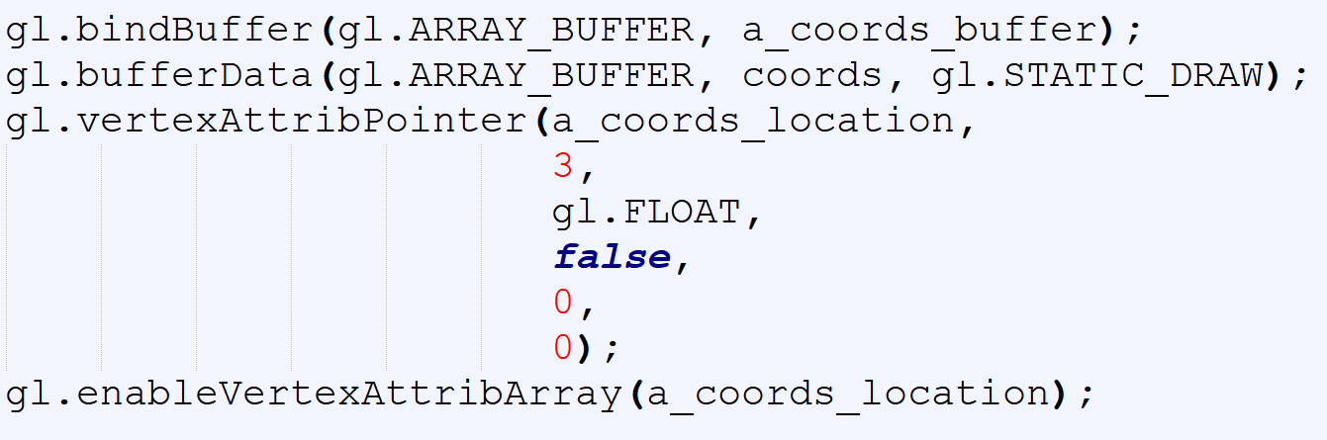
var canvas = document.getElementById("webglcanvas");
var gl = canvas.getContext("webgl");
var vertexShaderSource =
`attribute vec3 a_coords;
void main() {
gl_Position = vec4(a_coords, 1.0); }`;
var fragmentShaderSource =
`void main() {
gl_FragColor = vec4(1.0, 0.0, 0.0, 1.0); }`;
var vsh = gl.createShader( gl.VERTEX_SHADER );
gl.shaderSource( vsh, vertexShaderSource );
gl.compileShader( vsh );
var fsh = gl.createShader( gl.FRAGMENT_SHADER );
gl.shaderSource( fsh, fragmentShaderSource );
gl.compileShader( fsh );
var prog = gl.createProgram();
gl.attachShader( prog, vsh );
gl.attachShader( prog, fsh );
gl.linkProgram( prog );
gl.useProgram(prog);
var a_coords_location = gl.getAttribLocation(prog, "a_coords");
var coords = new Float32Array( [0.0, 0.0, 0.0,
0.0, 0.5, 0.0,
0.5, 0.0, 0.0] );
var a_coords_buffer = gl.createBuffer();
gl.bindBuffer(gl.ARRAY_BUFFER, a_coords_buffer);
gl.bufferData(gl.ARRAY_BUFFER, coords, gl.STATIC_DRAW);
gl.vertexAttribPointer(a_coords_location, 3, gl.FLOAT, false, 0, 0);
gl.enableVertexAttribArray(a_coords_location);
gl.clearColor(0.75, 0.75, 0.75, 1.0);
gl.clear(gl.COLOR_BUFFER_BIT);
gl.drawArrays(gl.TRIANGLES, 0, 3);
Canvas and WebGL context
Create and Compile Shaders
Associate the shader variable
Define geometry + color
and store it in buffer
Draw object

Slide 12

var canvas = document.getElementById("webglcanvas");
var gl = canvas.getContext("webgl");
var vertexShaderSource =
`attribute vec3 a_coords;
void main() {
gl_Position = vec4(a_coords, 1.0); }`;
var fragmentShaderSource =
`void main() {
gl_FragColor = vec4(1.0, 0.0, 0.0, 1.0); }`;
var vsh = gl.createShader( gl.VERTEX_SHADER );
gl.shaderSource( vsh, vertexShaderSource );
gl.compileShader( vsh );
var fsh = gl.createShader( gl.FRAGMENT_SHADER );
gl.shaderSource( fsh, fragmentShaderSource );
gl.compileShader( fsh );
var prog = gl.createProgram();
gl.attachShader( prog, vsh );
gl.attachShader( prog, fsh );
gl.linkProgram( prog );
gl.useProgram(prog);
var a_coords_location = gl.getAttribLocation(prog, "a_coords");
var coords = new Float32Array( [0.0, 0.0, 0.0,
0.0, 0.5, 0.0,
0.5, 0.0, 0.0] );
var a_coords_buffer = gl.createBuffer();
gl.bindBuffer(gl.ARRAY_BUFFER, a_coords_buffer);
gl.bufferData(gl.ARRAY_BUFFER, coords, gl.STATIC_DRAW);
gl.vertexAttribPointer(a_coords_location, 3, gl.FLOAT, false, 0, 0);
gl.enableVertexAttribArray(a_coords_location);
gl.clearColor(0.75, 0.75, 0.75, 1.0);
gl.clear(gl.COLOR_BUFFER_BIT);
gl.drawArrays(gl.TRIANGLES, 0, 3);
Canvas and WebGL context
Create and Compile Shaders
Associate the shader variable
Define geometry + color
and store it in buffer
Draw object

Slide 13
Problem – 1
We want to send color information from CPU 🡪 GPU
Not specified inside the shader
X

Slide 14
Uniform
Canvas and WebGL context
Create and Compile Shaders
Associate the shader variable
Define geometry + color
and store it in buffer
Draw object

Slide 15
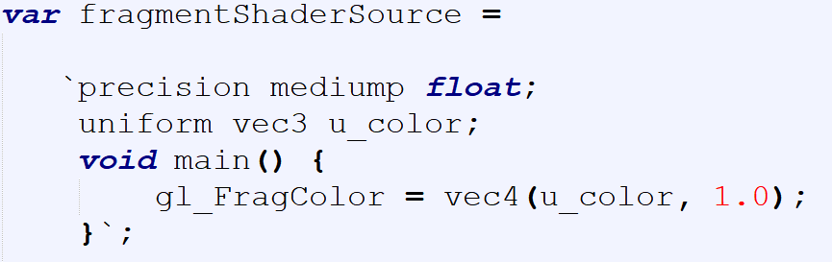
Uniform
Canvas and WebGL context
Create and Compile Shaders
Associate the shader variable
Define geometry + color
and store it in buffer
Draw object

Slide 16
Uniform
Canvas and WebGL context
Create and Compile Shaders
Associate the shader variable
Define geometry + color
and store it in buffer
Draw object

Slide 17
Uniform
Canvas and WebGL context
Create and Compile Shaders
Associate the shader variable
Define geometry + color
and store it in buffer
Draw object

Slide 18
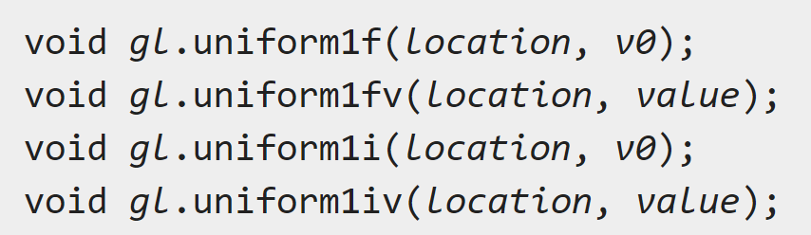
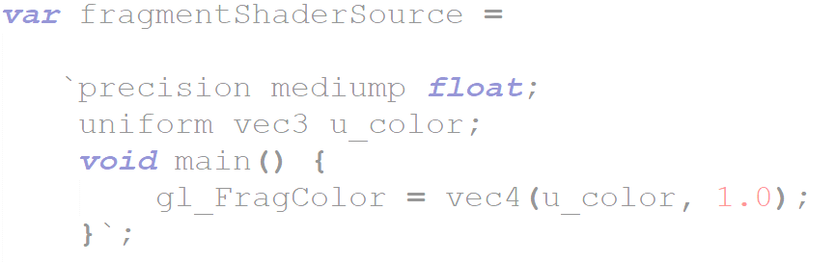
Uniform
Canvas and WebGL context
Create and Compile Shaders
Associate the shader variable
Define geometry + color
and store it in buffer
Draw object
gl.unifrom*: https://developer.mozilla.org/en-US/docs/Web/API/WebGLRenderingContext/uniform
https://developer.mozilla.org/en-US/docs/Web/API/WebGLRenderingContext/uniformMatrix

Slide 19
Problem – 1 | Uniform variable
Get the code:
rb.gy/nbuyoz

Slide 20

Uniform
var canvas = document.getElementById("webglcanvas");
var gl = canvas.getContext("webgl");
var vertexShaderSource =
`attribute vec3 a_coords;
void main() {
gl_Position = vec4(a_coords, 1.0); }`;
var fragmentShaderSource =
`precision mediump float;
uniform vec3 u_color;
void main() {
gl_FragColor = vec4(u_color, 1.0);
}`;
var vsh = gl.createShader( gl.VERTEX_SHADER );
gl.shaderSource( vsh, vertexShaderSource );
gl.compileShader( vsh );
var fsh = gl.createShader( gl.FRAGMENT_SHADER );
gl.shaderSource( fsh, fragmentShaderSource );
gl.compileShader( fsh );
var prog = gl.createProgram();
gl.attachShader( prog, vsh );
gl.attachShader( prog, fsh );
gl.linkProgram( prog );
gl.useProgram(prog);
var a_coords_location = gl.getAttribLocation(prog, "a_coords");
var coords = new Float32Array( [0.0, 0.0, 0.0,
0.0, 0.5, 0.0,
0.5, 0.0, 0.0] );
var a_coords_buffer = gl.createBuffer();
gl.bindBuffer(gl.ARRAY_BUFFER, a_coords_buffer);
gl.bufferData(gl.ARRAY_BUFFER, coords, gl.STATIC_DRAW);
gl.vertexAttribPointer(a_coords_location, 3, gl.FLOAT, false, 0, 0);
gl.enableVertexAttribArray(a_coords_location);
var u_color_location = gl.getUniformLocation(prog, "u_color");
var color = new Float32Array( [0.5, 0.7, 0.3] );
gl.uniform3fv(u_color_location, color);
gl.clearColor(0.75, 0.75, 0.75, 1.0);
gl.clear(gl.COLOR_BUFFER_BIT);
gl.drawArrays(gl.TRIANGLES, 0, 3);
Canvas and WebGL context
Create and Compile Shaders
Associate the shader variable
Define geometry + color
and store it in buffer
Draw object

Slide 21
Problem – 2
We want to shift the triangle via mouse clicking.

Slide 22
Clicking
var canvas = document.getElementById("webglcanvas");
var gl = canvas.getContext("webgl");
var a_coords_location = gl.getAttribLocation(prog, "a_coords");
var coords = new Float32Array( [0.0, 0.0, 0.0,
0.0, 0.5, 0.0,
0.5, 0.0, 0.0] );
var a_coords_buffer = gl.createBuffer();
gl.bindBuffer(gl.ARRAY_BUFFER, a_coords_buffer);
gl.bufferData(gl.ARRAY_BUFFER, coords, gl.STATIC_DRAW);
gl.vertexAttribPointer(a_coords_location, 3, gl.FLOAT, false, 0, 0);
gl.enableVertexAttribArray(a_coords_location);
var u_color_location = gl.getUniformLocation(prog, "u_color");
var color = new Float32Array( [0.5, 0.7, 0.3] );
gl.uniform3fv(u_color_location, color);
var u_shift_location = gl.getUniformLocation(prog, "u_shift");
var shift = 0.0;
gl.uniform1f(u_shift_location, shift);
gl.clearColor(0.75, 0.75, 0.75, 1.0);
gl.clear(gl.COLOR_BUFFER_BIT);
gl.drawArrays(gl.TRIANGLES, 0, 3);
canvas.onmousedown = function ()
{
shift = shift + 0.1;
gl.uniform1f(u_shift_location, shift);
gl.clearColor(0.75, 0.75, 0.75, 1.0);
gl.clear(gl.COLOR_BUFFER_BIT);
gl.drawArrays(gl.TRIANGLES, 0, 3);
};
var canvas = document.getElementById("webglcanvas");
var gl = canvas.getContext("webgl");
var vertexShaderSource =
`attribute vec3 a_coords;
uniform float u_shift;
void main() {
// gl_Position = vec4(a_coords, 1.0);
gl_Position = vec4(a_coords.x + u_shift, a_coords.y, a_coords.z, 1.0);
}`;
var fragmentShaderSource =
`precision mediump float;
uniform vec3 u_color;
void main() {
gl_FragColor = vec4(u_color, 1.0);
}`;
var vsh = gl.createShader( gl.VERTEX_SHADER );
gl.shaderSource( vsh, vertexShaderSource );
gl.compileShader( vsh );
var fsh = gl.createShader( gl.FRAGMENT_SHADER );
gl.shaderSource( fsh, fragmentShaderSource );
gl.compileShader( fsh );
var prog = gl.createProgram();
gl.attachShader( prog, vsh );
gl.attachShader( prog, fsh );
gl.linkProgram( prog );
gl.useProgram(prog);
Canvas and WebGL context
Create and Compile Shaders
Associate the shader variable
Define geometry + color
and store it in buffer
Draw object

Slide 23
Clicking
var canvas = document.getElementById("webglcanvas");
var gl = canvas.getContext("webgl");
var a_coords_location = gl.getAttribLocation(prog, "a_coords");
var coords = new Float32Array( [0.0, 0.0, 0.0,
0.0, 0.5, 0.0,
0.5, 0.0, 0.0] );
var a_coords_buffer = gl.createBuffer();
gl.bindBuffer(gl.ARRAY_BUFFER, a_coords_buffer);
gl.bufferData(gl.ARRAY_BUFFER, coords, gl.STATIC_DRAW);
gl.vertexAttribPointer(a_coords_location, 3, gl.FLOAT, false, 0, 0);
gl.enableVertexAttribArray(a_coords_location);
var u_color_location = gl.getUniformLocation(prog, "u_color");
var color = new Float32Array( [0.5, 0.7, 0.3] );
gl.uniform3fv(u_color_location, color);
var u_shift_location = gl.getUniformLocation(prog, "u_shift");
var shift = 0.0;
gl.uniform1f(u_shift_location, shift);
gl.clearColor(0.75, 0.75, 0.75, 1.0);
gl.clear(gl.COLOR_BUFFER_BIT);
gl.drawArrays(gl.TRIANGLES, 0, 3);
canvas.onmousedown = function ()
{
shift = shift + 0.1;
gl.uniform1f(u_shift_location, shift);
gl.clearColor(0.75, 0.75, 0.75, 1.0);
gl.clear(gl.COLOR_BUFFER_BIT);
gl.drawArrays(gl.TRIANGLES, 0, 3);
};
var canvas = document.getElementById("webglcanvas");
var gl = canvas.getContext("webgl");
var vertexShaderSource =
`attribute vec3 a_coords;
uniform float u_shift;
void main() {
// gl_Position = vec4(a_coords, 1.0);
gl_Position = vec4(a_coords.x + u_shift, a_coords.y, a_coords.z, 1.0);
}`;
var fragmentShaderSource =
`precision mediump float;
uniform vec3 u_color;
void main() {
gl_FragColor = vec4(u_color, 1.0);
}`;
var vsh = gl.createShader( gl.VERTEX_SHADER );
gl.shaderSource( vsh, vertexShaderSource );
gl.compileShader( vsh );
var fsh = gl.createShader( gl.FRAGMENT_SHADER );
gl.shaderSource( fsh, fragmentShaderSource );
gl.compileShader( fsh );
var prog = gl.createProgram();
gl.attachShader( prog, vsh );
gl.attachShader( prog, fsh );
gl.linkProgram( prog );
gl.useProgram(prog);
Canvas and WebGL context
Create and Compile Shaders
Associate the shader variable
Define geometry + color
and store it in buffer
Draw object

Slide 24
Clicking
var canvas = document.getElementById("webglcanvas");
var gl = canvas.getContext("webgl");
var a_coords_location = gl.getAttribLocation(prog, "a_coords");
var coords = new Float32Array( [0.0, 0.0, 0.0,
0.0, 0.5, 0.0,
0.5, 0.0, 0.0] );
var a_coords_buffer = gl.createBuffer();
gl.bindBuffer(gl.ARRAY_BUFFER, a_coords_buffer);
gl.bufferData(gl.ARRAY_BUFFER, coords, gl.STATIC_DRAW);
gl.vertexAttribPointer(a_coords_location, 3, gl.FLOAT, false, 0, 0);
gl.enableVertexAttribArray(a_coords_location);
var u_color_location = gl.getUniformLocation(prog, "u_color");
var color = new Float32Array( [0.5, 0.7, 0.3] );
gl.uniform3fv(u_color_location, color);
var u_shift_location = gl.getUniformLocation(prog, "u_shift");
var shift = 0.0;
gl.uniform1f(u_shift_location, shift);
gl.clearColor(0.75, 0.75, 0.75, 1.0);
gl.clear(gl.COLOR_BUFFER_BIT);
gl.drawArrays(gl.TRIANGLES, 0, 3);
canvas.onmousedown = function ()
{
shift = shift + 0.1;
gl.uniform1f(u_shift_location, shift);
gl.clearColor(0.75, 0.75, 0.75, 1.0);
gl.clear(gl.COLOR_BUFFER_BIT);
gl.drawArrays(gl.TRIANGLES, 0, 3);
};
var canvas = document.getElementById("webglcanvas");
var gl = canvas.getContext("webgl");
var vertexShaderSource =
`attribute vec3 a_coords;
uniform float u_shift;
void main() {
// gl_Position = vec4(a_coords, 1.0);
gl_Position = vec4(a_coords.x + u_shift, a_coords.y, a_coords.z, 1.0);
}`;
var fragmentShaderSource =
`precision mediump float;
uniform vec3 u_color;
void main() {
gl_FragColor = vec4(u_color, 1.0);
}`;
var vsh = gl.createShader( gl.VERTEX_SHADER );
gl.shaderSource( vsh, vertexShaderSource );
gl.compileShader( vsh );
var fsh = gl.createShader( gl.FRAGMENT_SHADER );
gl.shaderSource( fsh, fragmentShaderSource );
gl.compileShader( fsh );
var prog = gl.createProgram();
gl.attachShader( prog, vsh );
gl.attachShader( prog, fsh );
gl.linkProgram( prog );
gl.useProgram(prog);
Canvas and WebGL context
Create and Compile Shaders
Associate the shader variable
Define geometry + color
and store it in buffer
Draw object

Slide 25
Problem – 2 | Mouse Interaction
Get the code:
rb.gy/ddbnlv

Slide 26
Problem – 3
We want different color in different vertices and the color of the face will be blended accordingly.

Slide 27
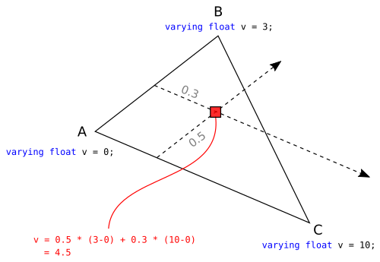
Interpolation
Source: https://stackoverflow.com/questions/17537879/in-webgl-what-are-the-differences-between-an-attribute-a-uniform-and-a-varying

Slide 28
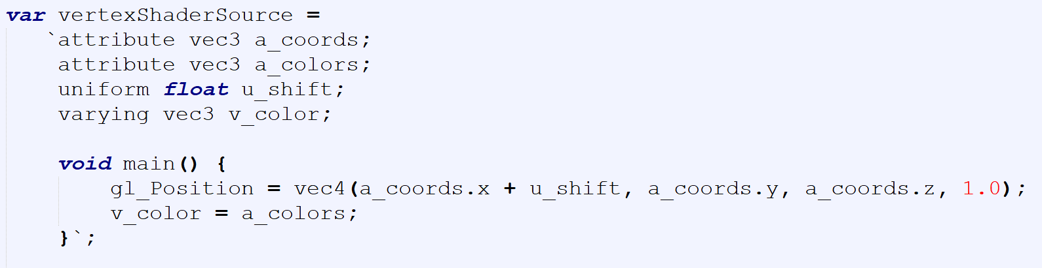
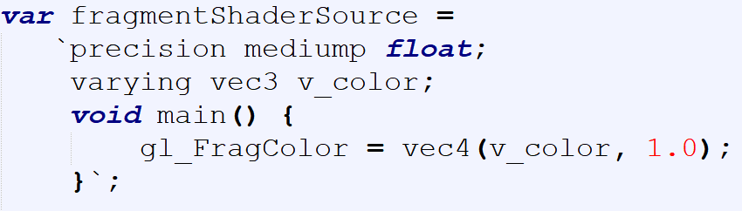
Varying

Slide 29
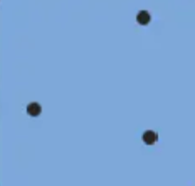
Varying
green
red
blue

Slide 30
Varying
green
red
blue

Slide 31
Varying
green
red
blue
Interpolation

Slide 32

Varying
green
red
blue

Slide 33
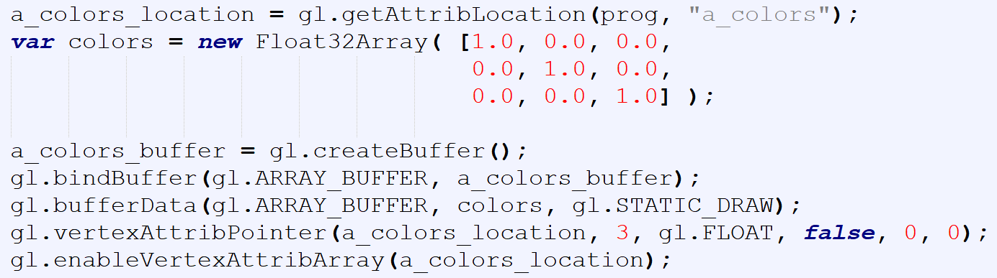
Varying
Canvas and WebGL context
Create and Compile Shaders
Associate the shader variable
Define geometry + color
and store it in buffer
Draw object

Slide 34
Problem – 3 | Varying Variable
Get the code:
rb.gy/p7u46l

Slide 35
Uniform vs Attribute vs Varying
uniform are per-primitive parameters
constant during an entire draw call
attribute are per-vertex parameters
typically : positions, normals, colors, UVs, ...
varying are per-fragment (or per-pixel) parameters
they vary from pixels to pixels
Source: https://stackoverflow.com/questions/17537879/in-webgl-what-are-the-differences-between-an-attribute-a-uniform-and-a-varying

Slide 36
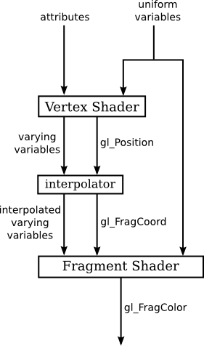
Flow of data
Source: http://math.hws.edu/graphicsbook/c6/s1.html

Slide 37
Notes
Attribute can only be used in vertex shader. [why?]
Uniform can be used in both vertex and fragment shaders. [why?]
Varying must be used in both vertex and fragment shaders with the same name.
Uniform, attributes and varying must be declared globally in the shaders.
It is a convention to use –
a_ before the name of the attribute variable
u_ before the name of the uniform variable
v_ before the name of the varying variable

Slide 38
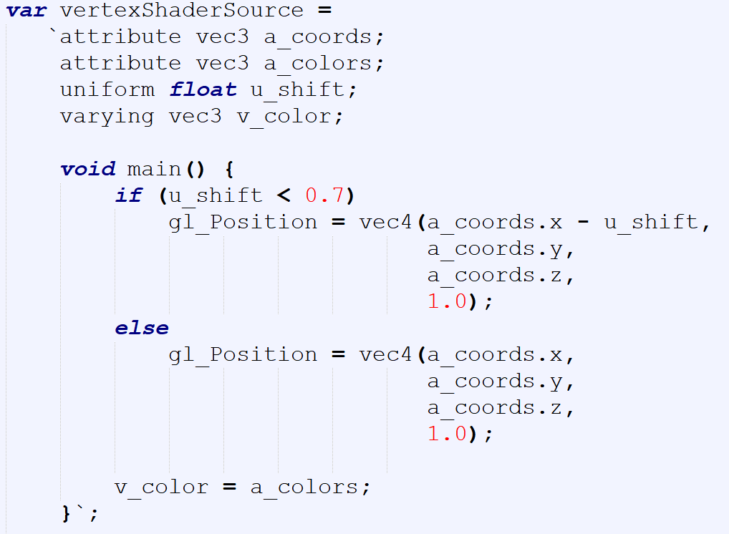
Control Statements in GLSL
Question: What will happen here?
More on GLSL statements: https://www.shaderific.com/glsl-statements

Slide 39
GLSL If Else
Get the code:
rb.gy/qdtslu

Slide 40
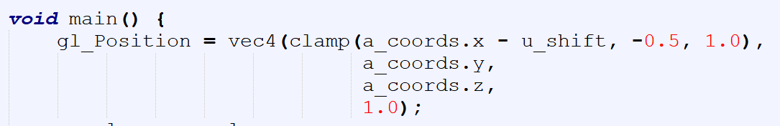
Built-in Functions in GLSL
Question: What will happen here?
More GLSL built-in functions: https://www.shaderific.com/glsl-functions

Slide 41
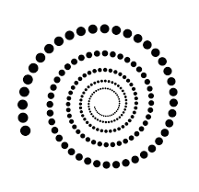
Assignment - 1
Part A
For each click, a 2D spiral will keep increasing.
The every dot will be a pixel.
The outer dots will be bigger than the inner ones depending on the distance from the center.

Slide 42
Assignment - 1
Part B
Create a 2D scenario [use your imagination]
Minimum 20 triangles
Apply color [using varying]
Have a keyboard interaction
With control statements and/or built-in function

Slide 43
Assignment – 1
Viva

